Slide 1
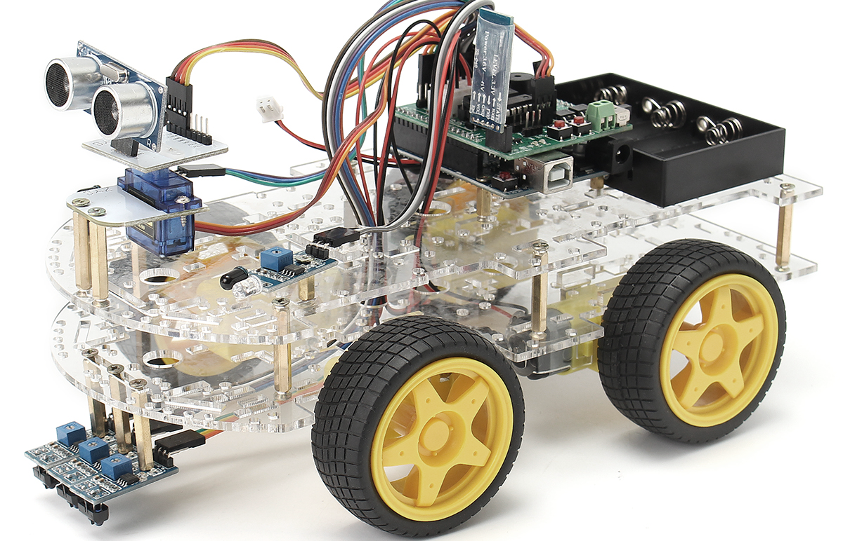
PRESENTATION ON OBSTACLE AVOIDING ROBOT
GROUP MEMBERS: (CT-057) NOOR SHAUKAT
(CT-053) NEHA KHALID

Slide 2

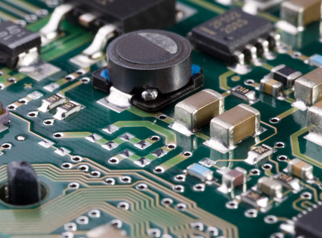
ADVISOR: DEPARTMENT:
NED UNIVERSITY OF ENIGINEERING AND TECHNOLOGY
SIR.TALHA AKHTAR
COMPUTER SCIENCE AND INFORMATION TECHNOLOGY

Slide 3
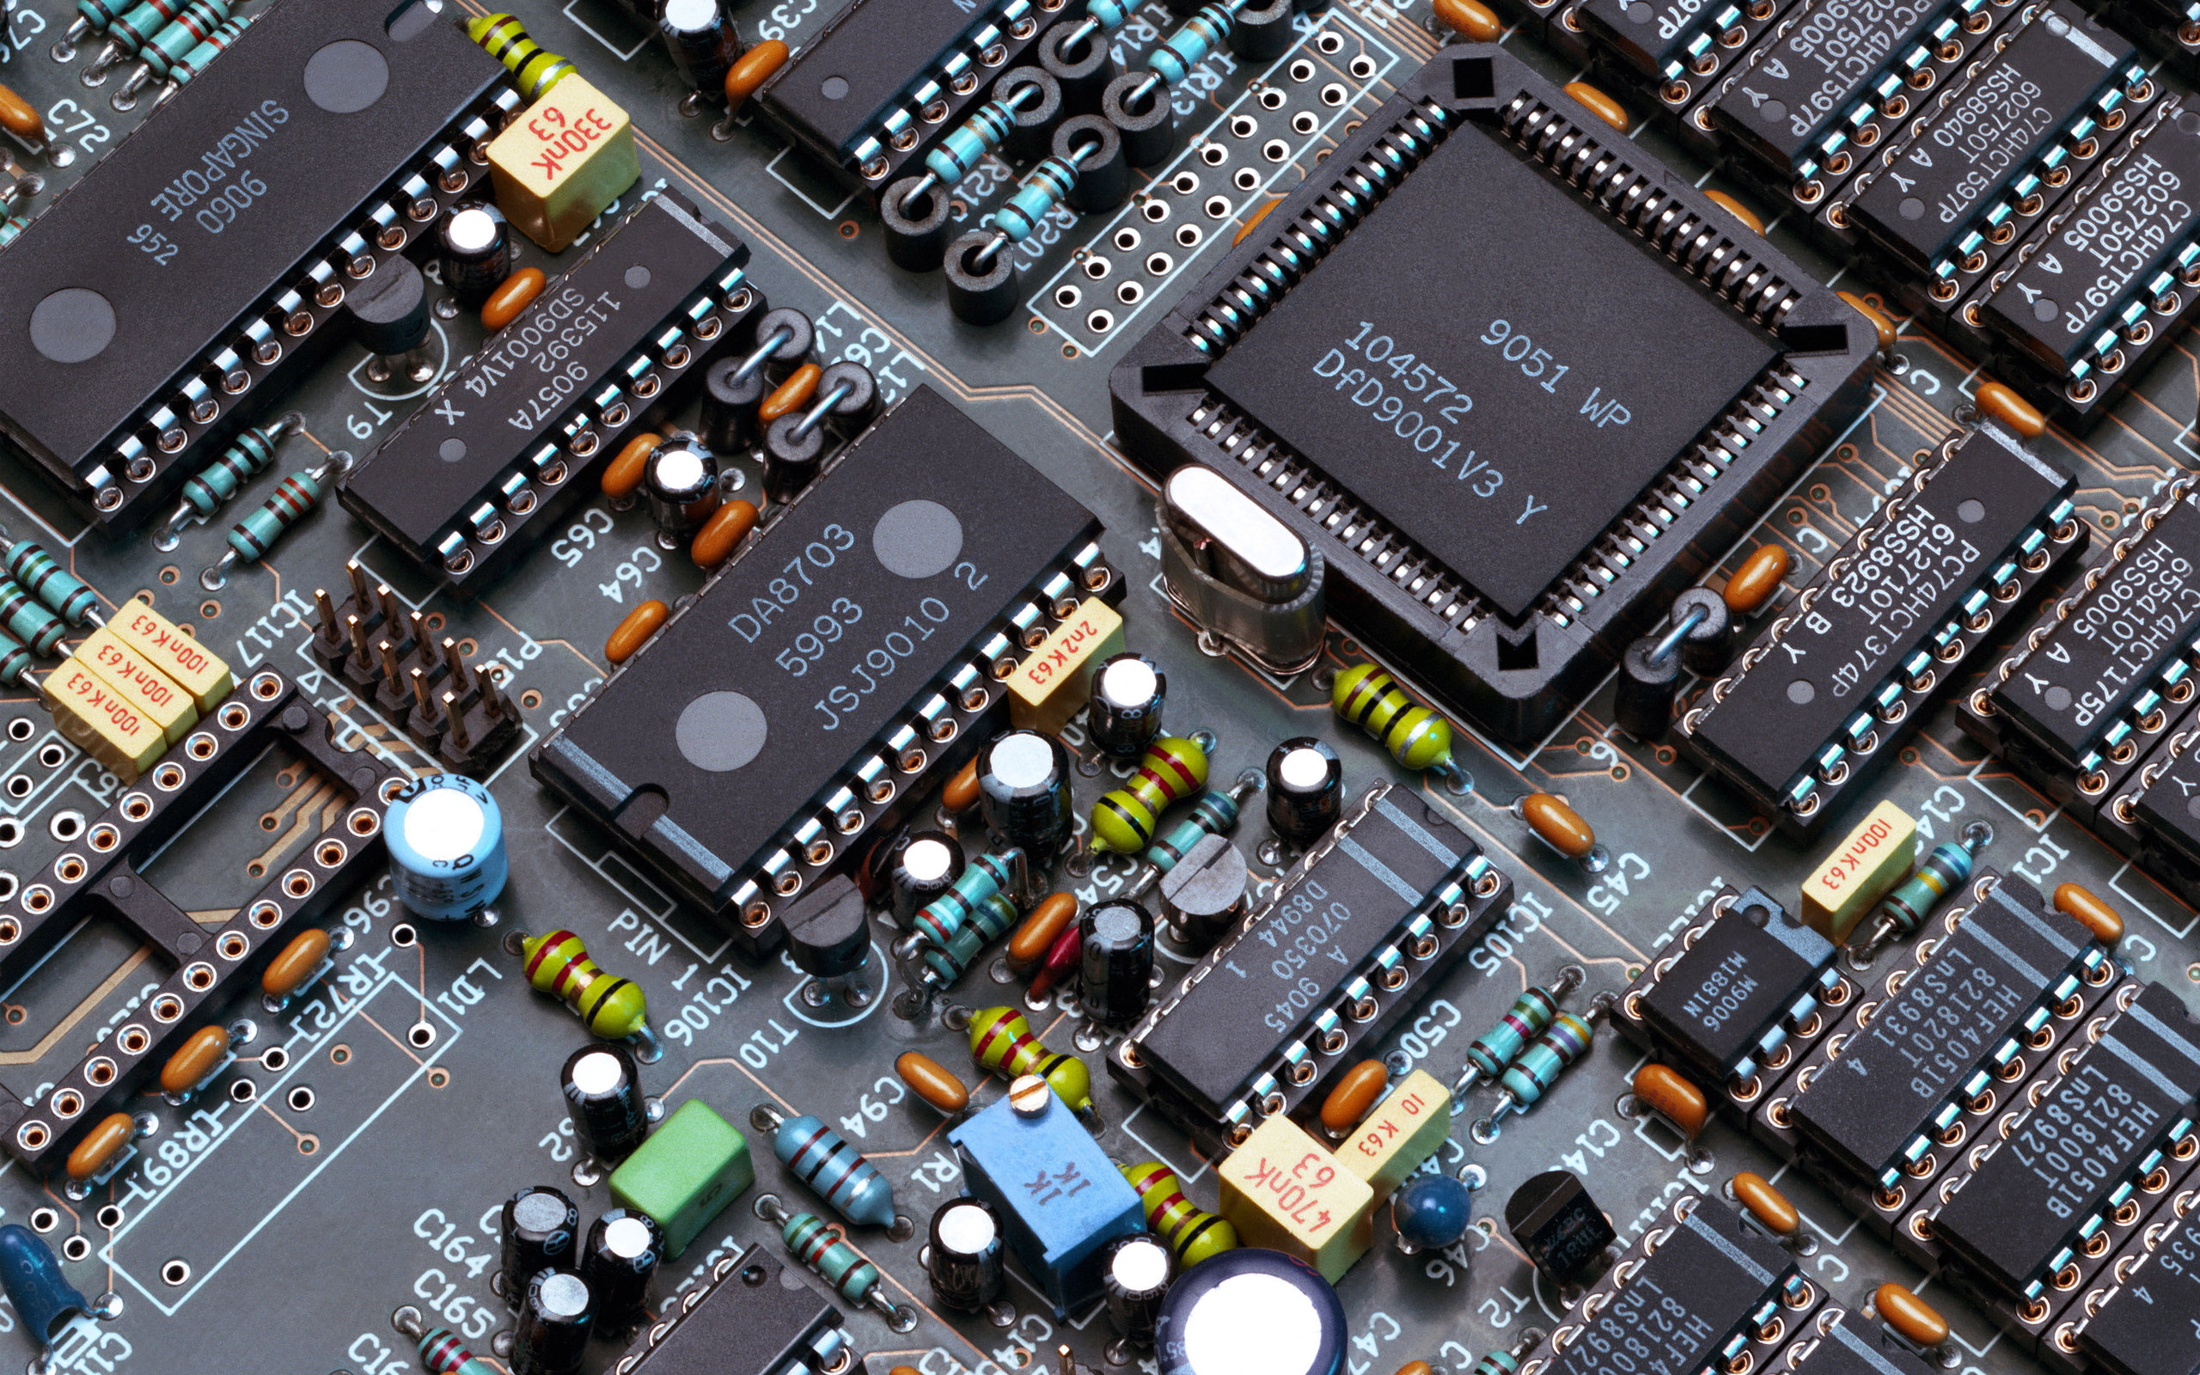
PROJECT CONTEXT
INTRODUCTION TO PROJECT
COMPONENTS AND REQUIREMENTS
EXPLAINATION OF COMPONENTS
BLOCK DIAGRAM
WORKING PRINCIPLE
CIRCUIT DIAGRAM
CONCLUSION

Slide 4
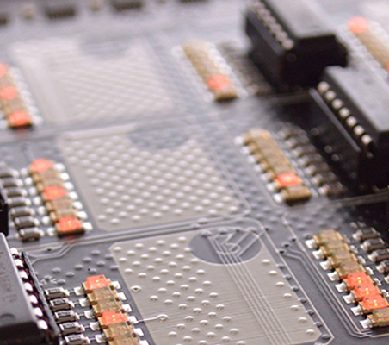
About Us
We, SCIT Students are here to represent the idea of obstacle avoiding robot as our LDST semester project.
INTRODUCTION TO PROJECT
An obstacle avoiding robot is an intelligent electronic device that responses to objects in front of it and changes it’s direction according to it.
It can automatically sense and overcome obstacles in it’s path.
This robot has been made by using basic electronic components.
As, it shows movement and functions automatically so it’s called as a Robot.

Slide 5
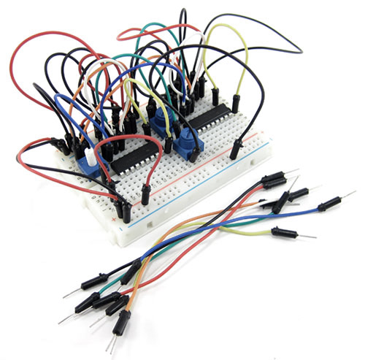
Components And Requirements
Following are the components that were required and has been used in the completion of this project.
COMPONENTS:
Small bread board
Jumper wires (of both types female to female & male to female)
Battery
Gear motors & wheels
IR sensors
L7293D IC
7404 IC

Slide 6
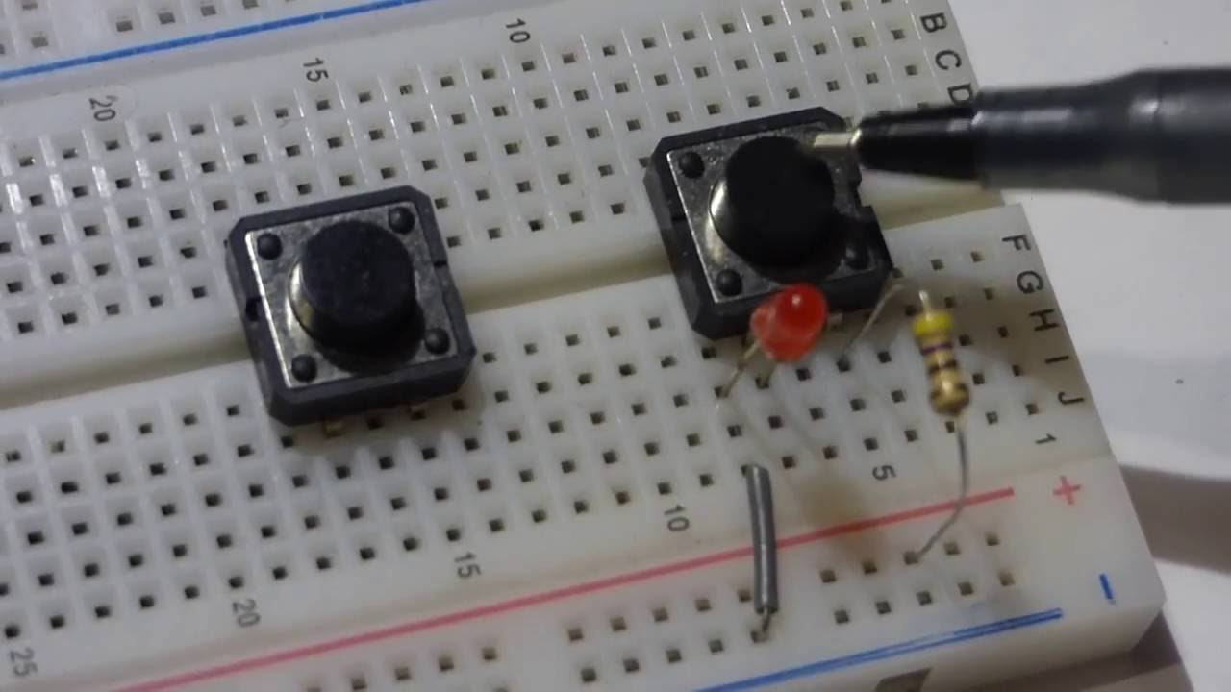
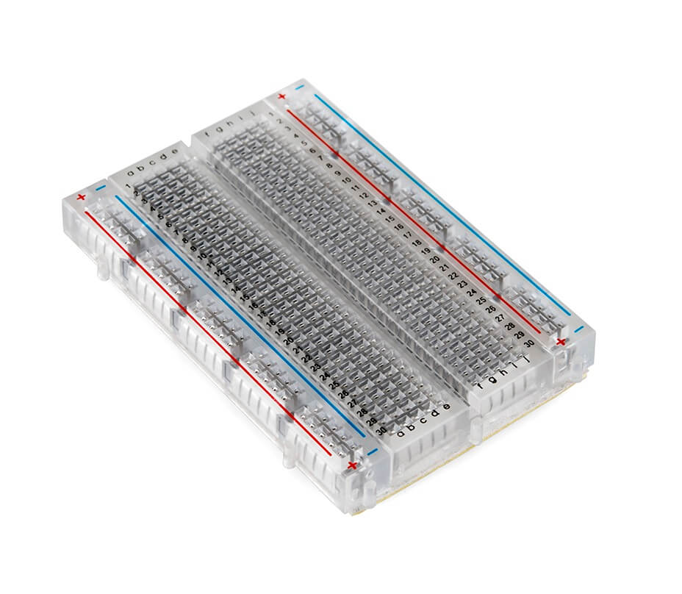
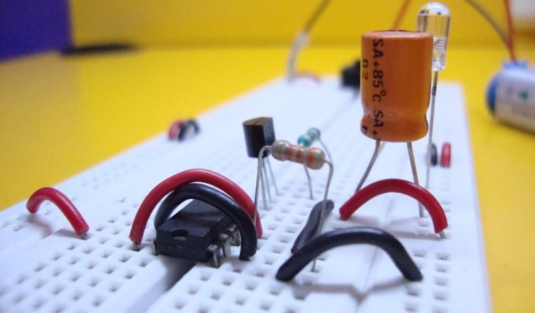
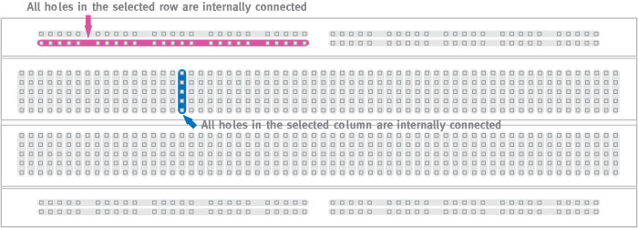
Explanation Of Components
BREAD BOARD
A breadboard is a solderless device for temporary prototype with electronics and test circuit device.
Most electronic components in electronic circuits can be interconnected by inserting their leads or terminals into the holes and then making connections through wires where appropriate.
note that all holes in the selected row are connected together, so the holes in the selected column. The set of connected holes can be called a node.

Slide 7
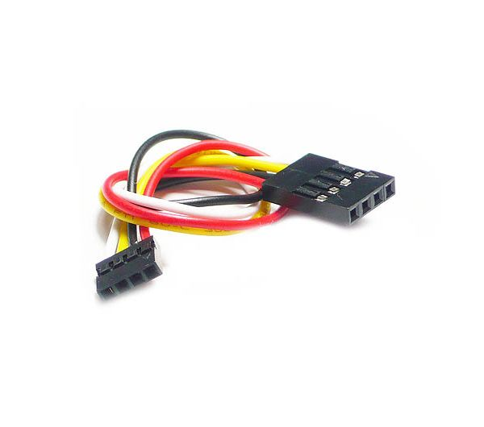
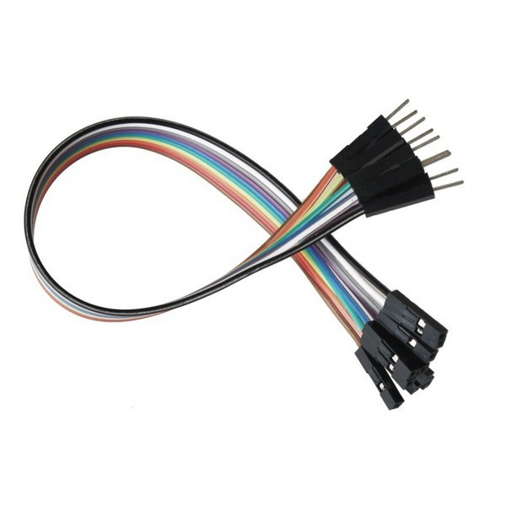
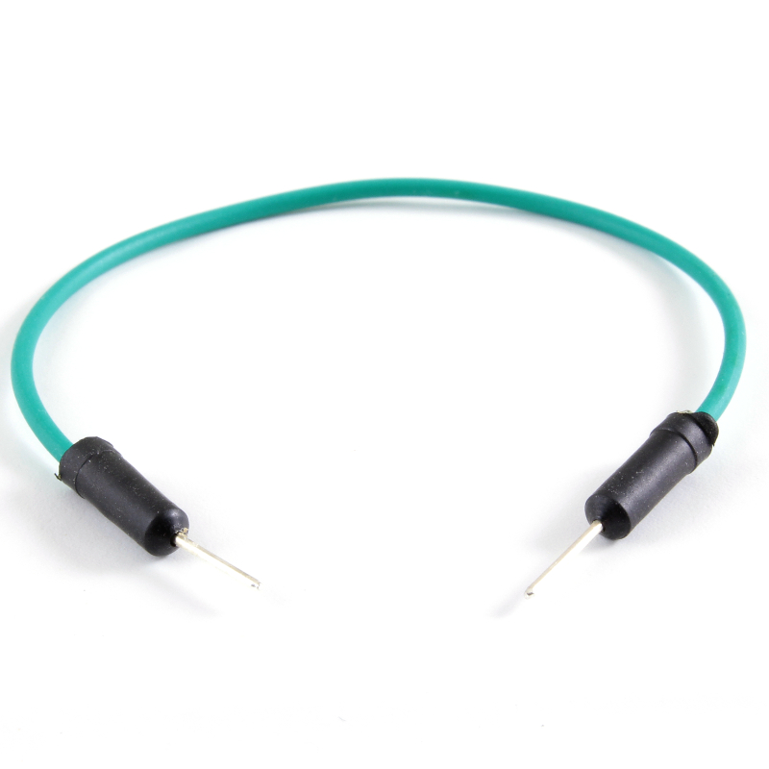
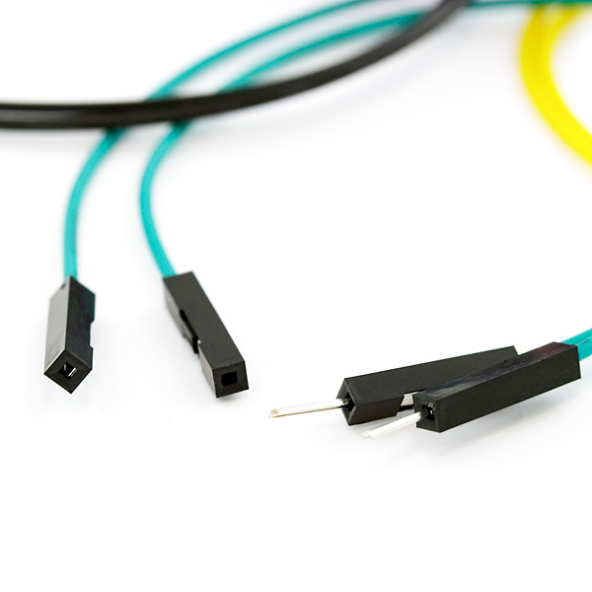
Continue……..
JUMPER WIRES
Jumper wires simply refers to a conducting wire that establishes an electric connection between two points in a circuit.
They are typically in three versions :
Male to male
Female to female
Male to female
The difference in each is the end part of the wire.

Slide 8
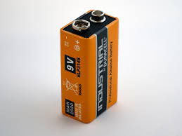
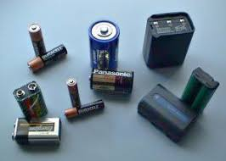
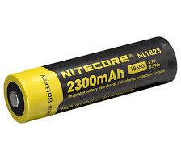
Continue……..
BATTERY
A battery is a device consisting of one or more electrochemical cells with external connections for powering electrical devices such as flashlights, mobile phones, and electric cars.
When a battery is supplying electric power, its positive terminal is the cathode and its negative terminal is the anode.
We have used 9Volt battery supply in our project construction.

Slide 9
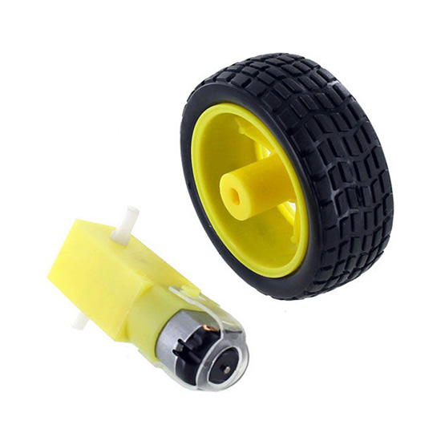
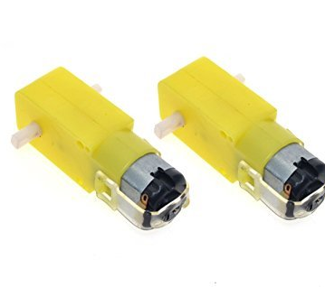
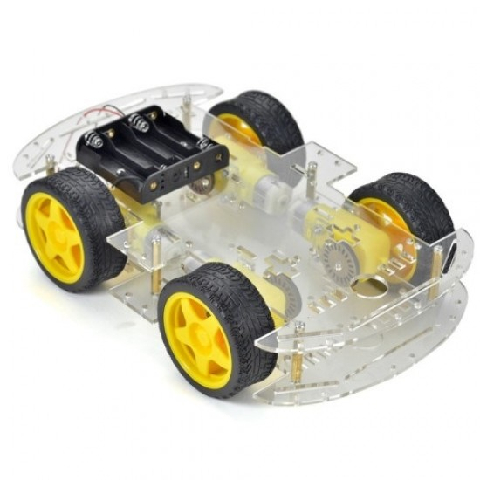
Continue……..
GEAR MOTORS AND WHEELS
A gear motor is a specific type of electrical motor that is designed to produce high torque while maintaining a low horsepower, or low speed, motor output.
We have used gear motors for the movement of the obstacle avoiding robot, in both direction back and fort.

Slide 10
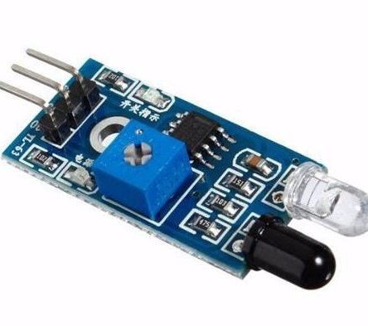
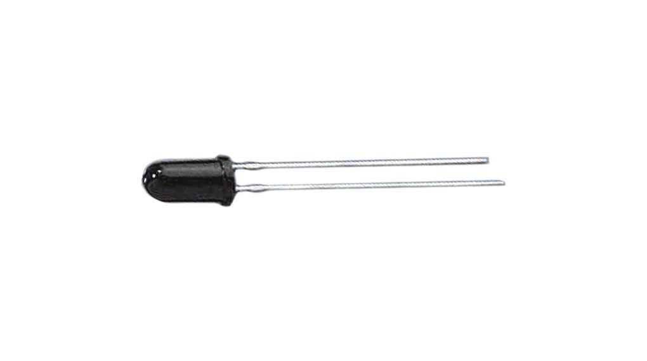
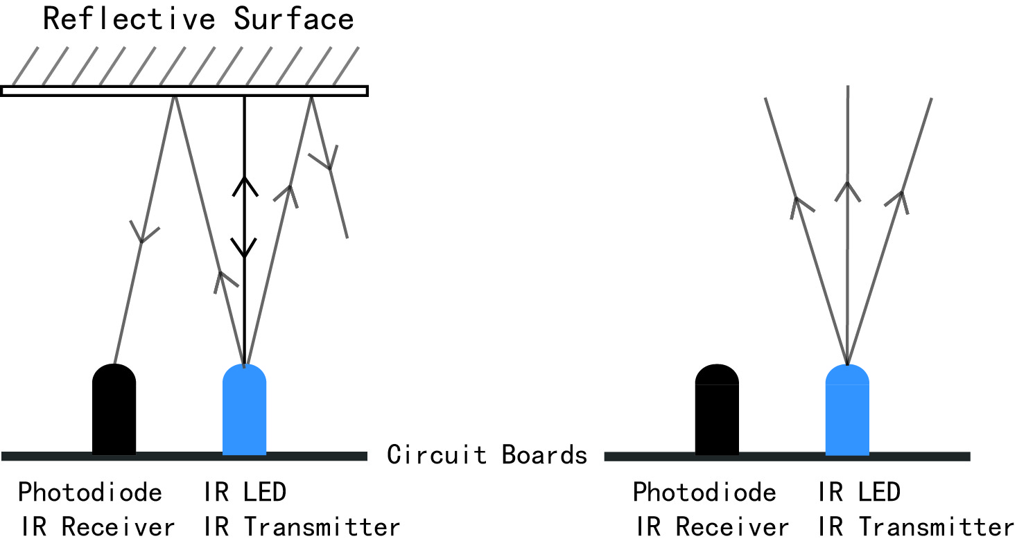
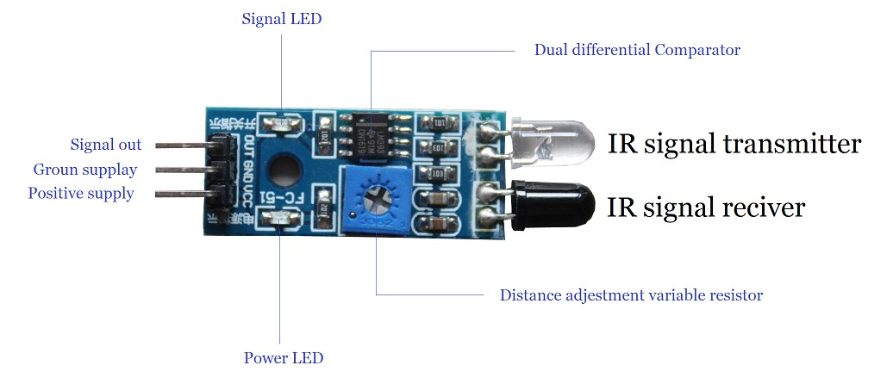
Continue……..
IR SENSORS
IR stands for Infra Red Sensor.
It has three terminals two act as input(GND & Vcc) and one as output(OUT).
It can detect the movement of objects by using the heat generated by them.
An IR sensor can be active or passive. An active IR sensor keeps emitting IR rays and when it doesn't get back the amount of rays it has reflected, it detects an object.
So do it generates signal out and signal LED also turns on.

Slide 11
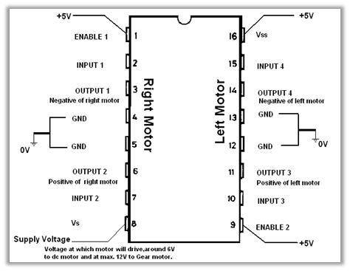
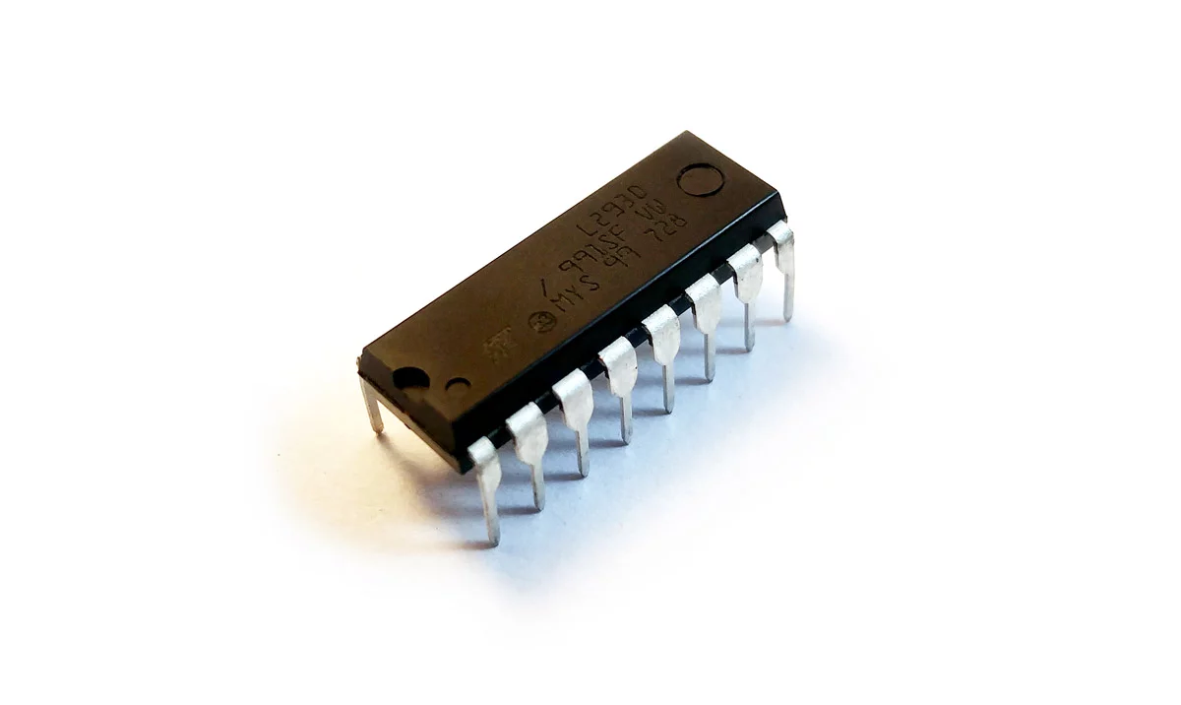
Continue……..
L7293D IC
This is a motor driver IC that can drive two motor simultaneously.
L293D IC is a dual H-bridge motor driver IC.
One H-bridge is capable to drive a dc motor in bidirectional.
L293D IC is a current enhancing IC as the output from the sensor is not able to drive motors itself so L293D is used for this purpose.
L293D is a 16 pin IC having two enables pins which should always be remain high to enable both the H-bridges.

Slide 12
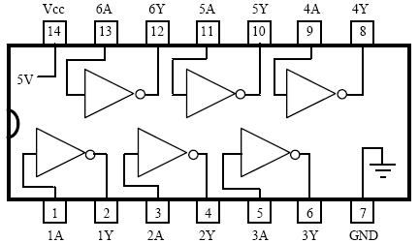
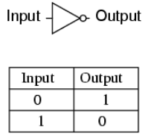
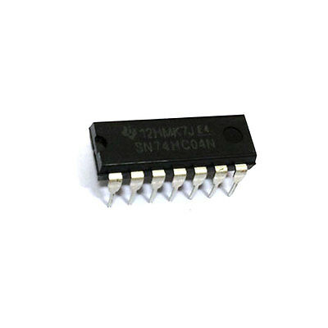
Continue……...
7404 IC
7404 IC is an inverter IC.
7404 IC contains six independent each of which performs logic Inverter function.
Vcc is applied to 14th pin and GND to 7th pin of the IC.
Truth table:

Slide 13
Block Diagram
Working/movement representation of obstacle avoiding robot.
START
SIGNALS FROM IR SENSOR
INPUT FROM BOTH IR SENSORS
INPUT FROM RIGHT IR SENSOR
INPUT FROM LEFT IR SENSOR
NO INPUT FROM IR SENSORS
LEFT MOTOR MOVE REVERSE,RIGHT STOPS
RIGHT MOTOR MOVE REVERSE,LEFT STOPS
RIGHT AND LEFT MOTORS MOVE REVERSE
RIGHT AND LEFT MOTORS MOVE FORWARD

Slide 14
Working Principle
The obstacle avoiding robot uses infrared sensors for its movement.
A motor driver IC, L293D IC is use to achieve the desire operation.
Whenever the robot is going on a desire path it transmits the infrared radiation from it’s sensor head.
And if it receives less amount of radiations back, then that were transmitted it performs operation according to the input.
As, if both IR sensors receive or not receive the signal, the L239D IC rotates both the tyres in reverse or forward direction.
As, both H-bridge get activated.
Where as, in activation of one IR sensor alternative tyre starts to rotate in backward direction.
If non of the two IR sensors get activated both the tyres continue their movement in forward direction.
And a 7404 IC has also been used to invert the output from the IR sensor OUT(signal), to manage motor movement.
When signal OUT=0, the motor moves forward and at OUT=1 the motor moves backward (respectively from which sensor, it gets output as 1).

Slide 15
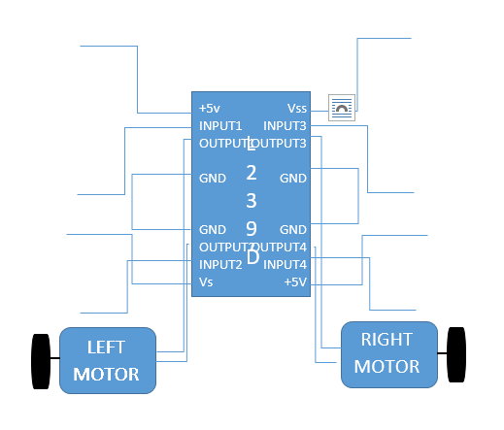
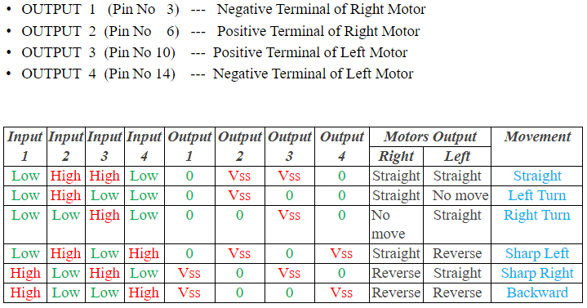
Explanation through chart
OUTPUT CONNECTIONS

Slide 16
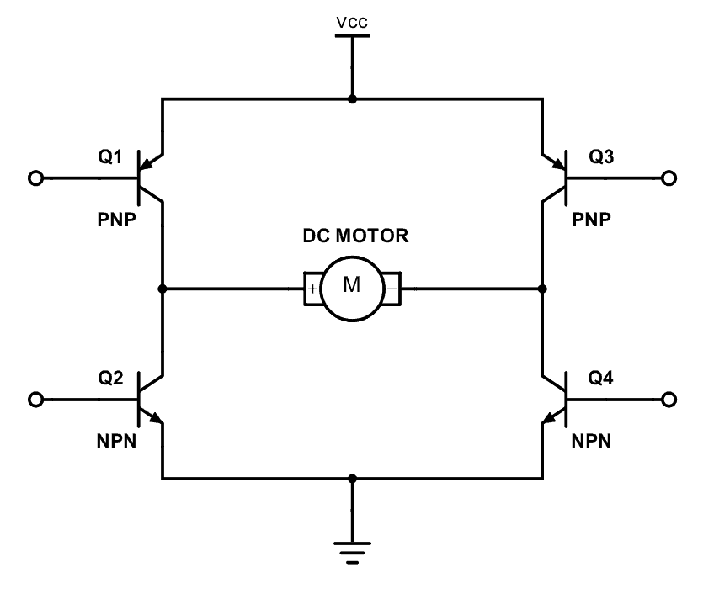
Application
About H-Bridge
An H bridge is an electronic circuit that switches the polarity of a voltage applied to a load. These circuits are often used in robotics and other applications to allow DC motors to run forwards or backwards.
Now day’s many industries are using robots due to their high level of performance and reliability and which is a great help for human beings. The obstacle avoiding robot is used for detecting obstacles and avoiding the collision.
They are used in many home appliances as vacuum cleaners, and other robots as well.
It is used where human vision error can occur, as human can not see these radiations , beams through naked eyes.

Slide 17
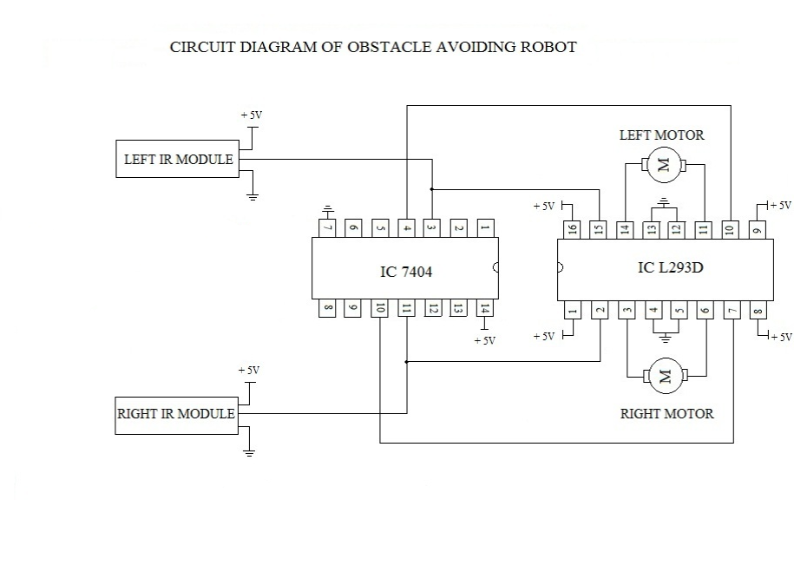
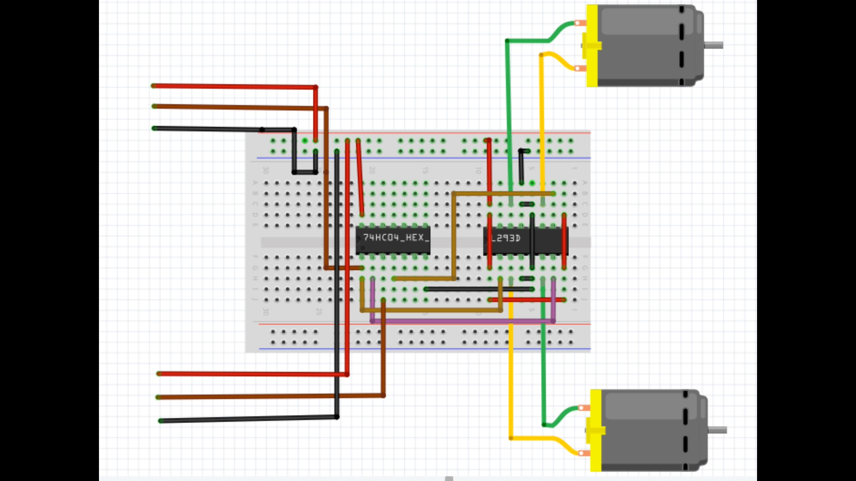
CIRCUIT DIAGRAM(CONNECTIONS)

Slide 18
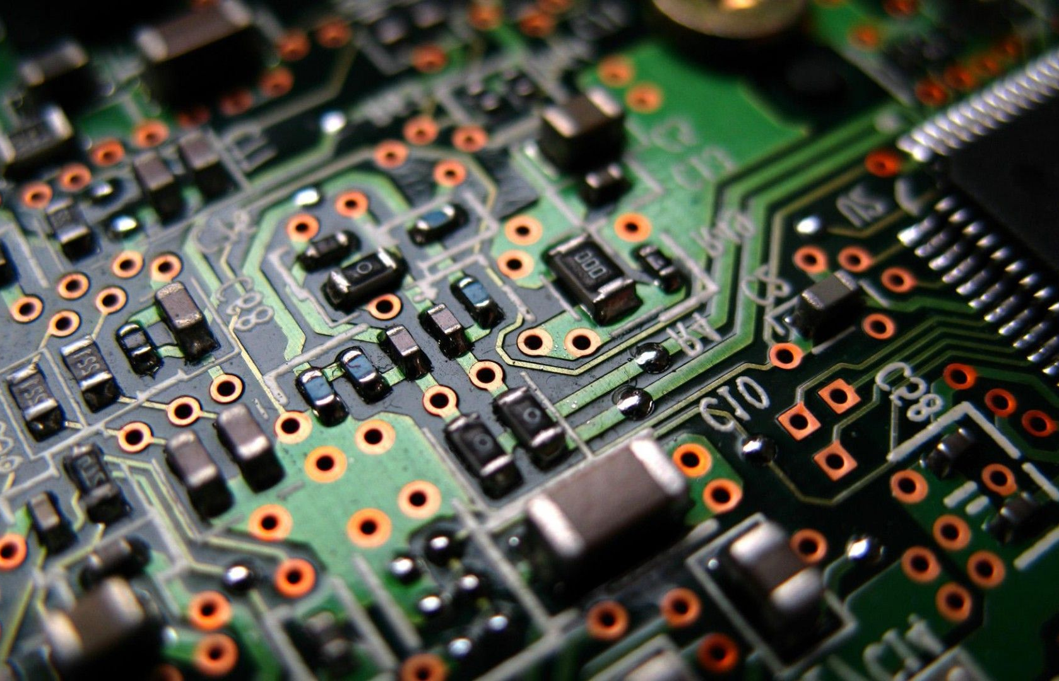
Thank You

